Slide 1
Human-Computer Interaction Project Phase 2
R16C - Group 5
Present by Jacky, Michela, Zelin

Slide 2
Content
Initial conceptual model
Possible interaction modes
Validating the Conceptual Model
Storyboards
Informal feedbacks
Paper prototype
Two most promising prototypes
Prototype sets
The strongest design

Slide 3
Initial conceptual model
possible interaction modes：
1. Conversing: when the user needs to use the navigation mode of the app, conversing as an interaction type would be very helpful, since when walking or driving, it will be much safer and convenient if users can set their routes without looking their screens.
2: Responding: different users have different personalities and preferences, the app need to automatically analysis which type of recommendation can give to several people (eg. If the user prefers trains, the route will more likely to let the user take trains, if the user is at free time, the route will more likely to let the user go through recreation area to rest)
3: Manipulating: like most apps the user need to moving, selecting, dragging, opening different elements. If our apps have the same feature like this, the users are more likely to learn how to user the app faster.

Slide 4
interface type that fit our identified interaction modes
Manipulating is the interaction types that have more advantages, it can be designed to have general purposes, no matter the user want to navigate themselves, set their to do list or customize their settings, they can direct manipulate the system, and the system can easily understand that. It gives continuous representation of the objects and actions of interest.
The main metaphor is Map, and interaction style is manipulating, since the main purpose of using this app is to plan daily commute, so navigation mode needs to be highlighted, and with manipulating the map, drag it until the place the user want to go is in the center, or just type the location, the route can automatically generate. And if the user wants to add further information like when to go or which route can be cheaper, or which takes shorter time. They can click the route and type these in. These actions can be done without any thinking mostly, because this is the way people thinking when they want to plan daily commute, think the places want to go, then when to go, after that, which route is better.

Slide 5
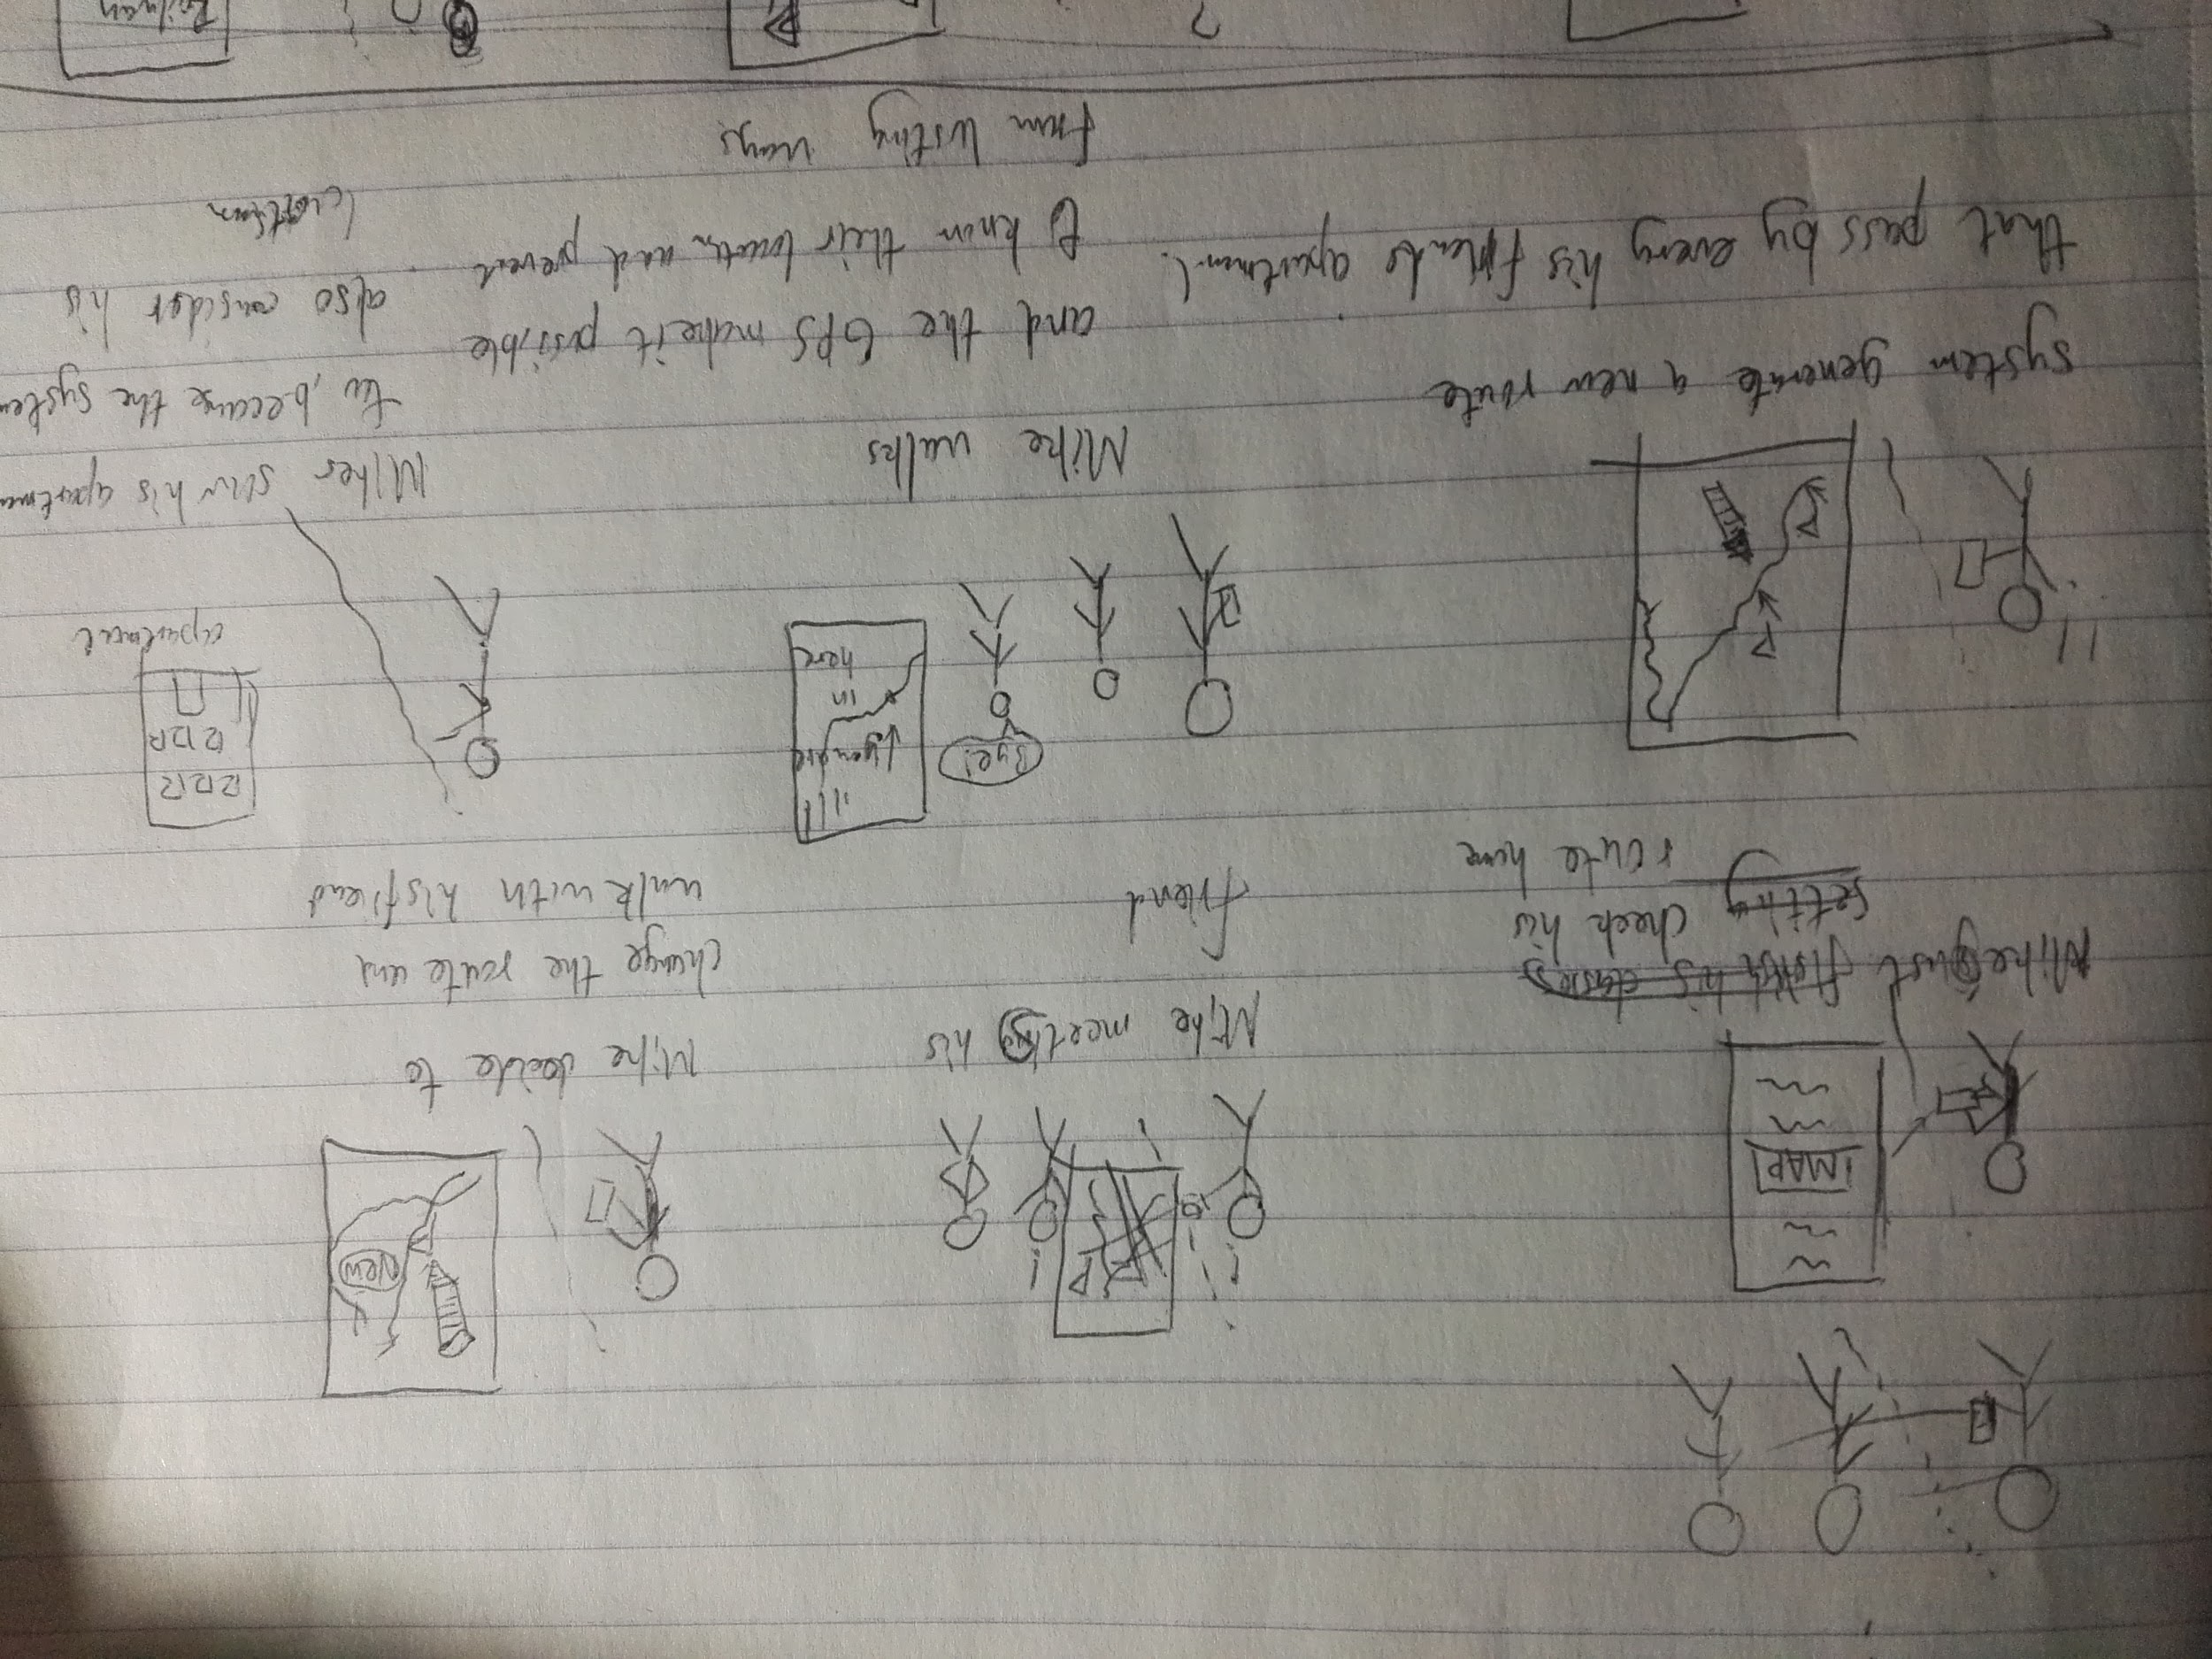
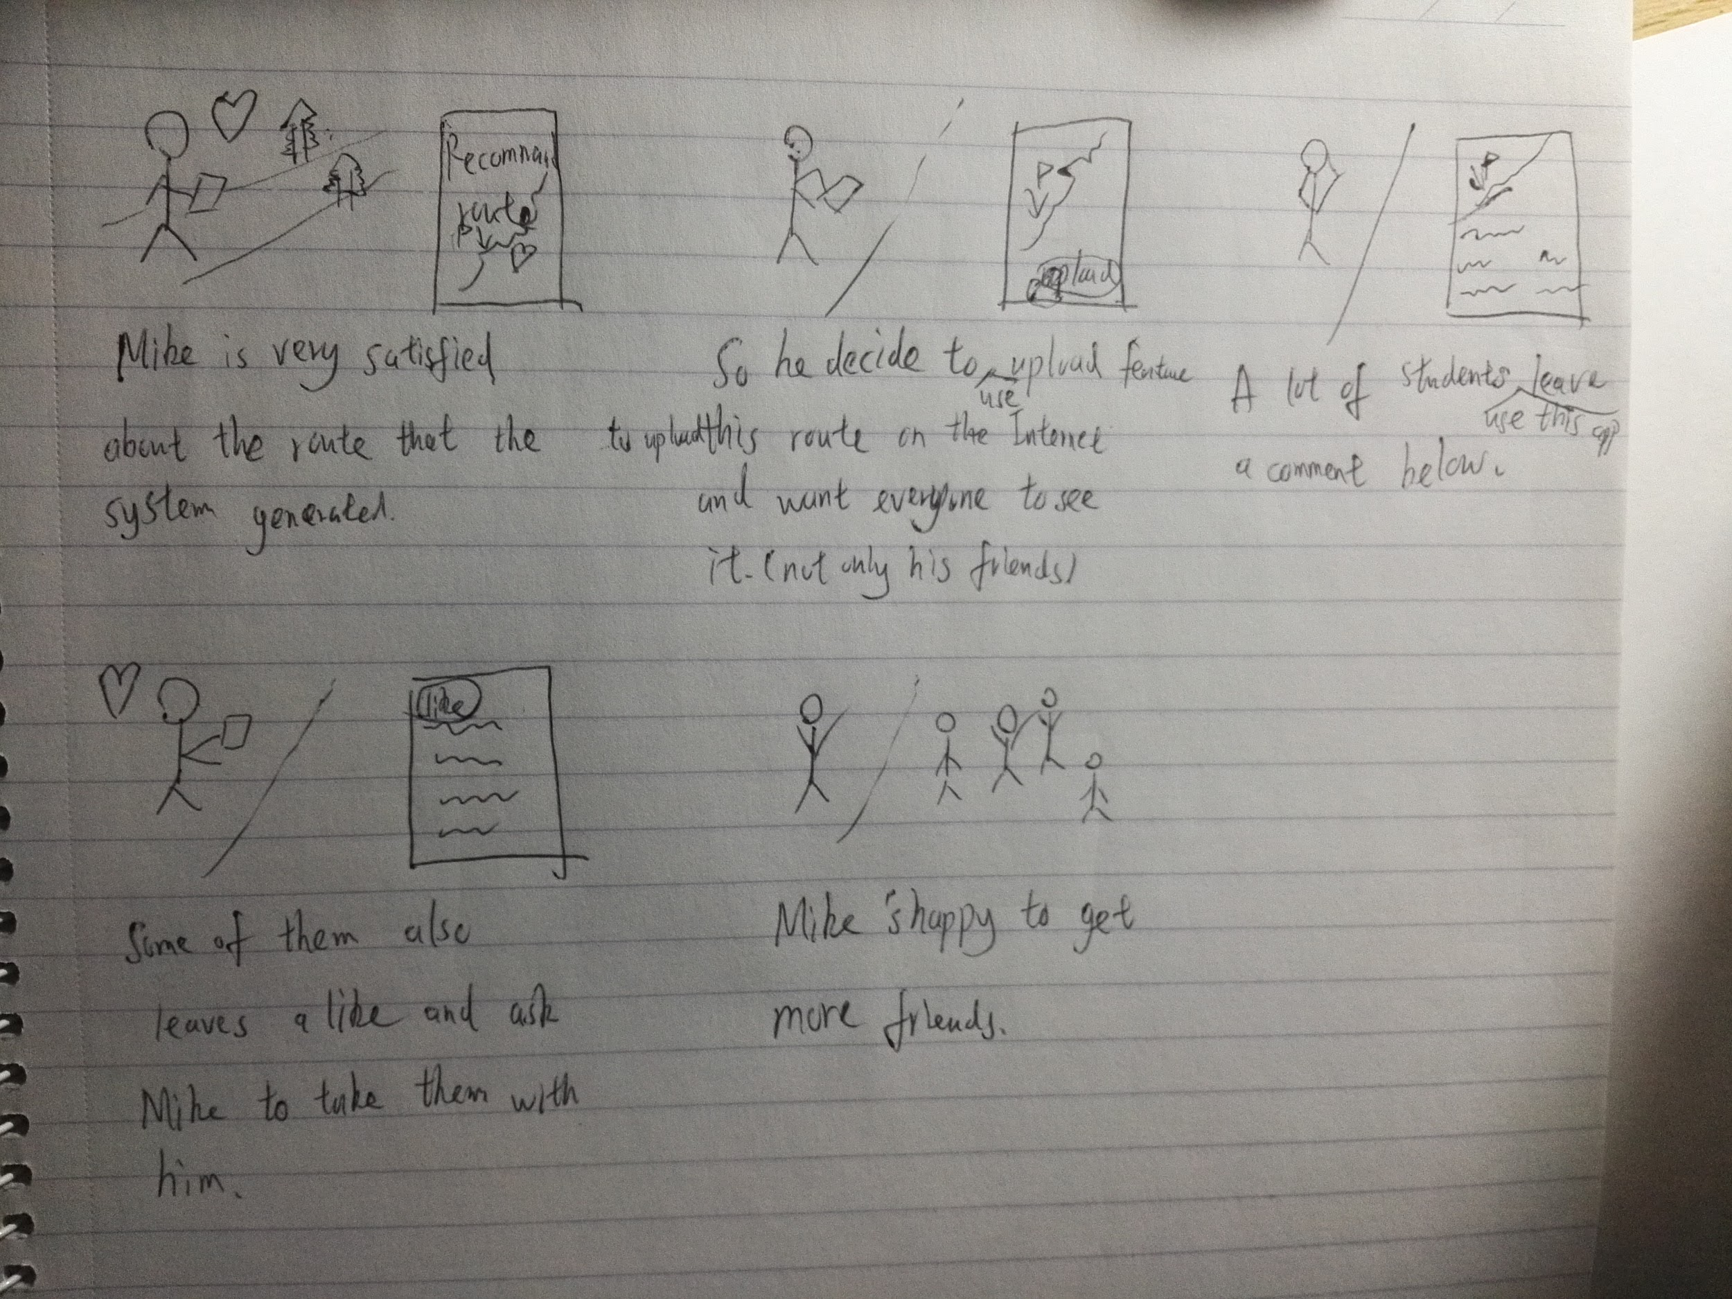
Validating the Conceptual Model
feedback: The feature of connect different locations in one route looks very handy, but can the system decide the priority of these locations?
feedback:It would be very nice to let this feature can also apply to the people who don’t have this app.

Slide 6
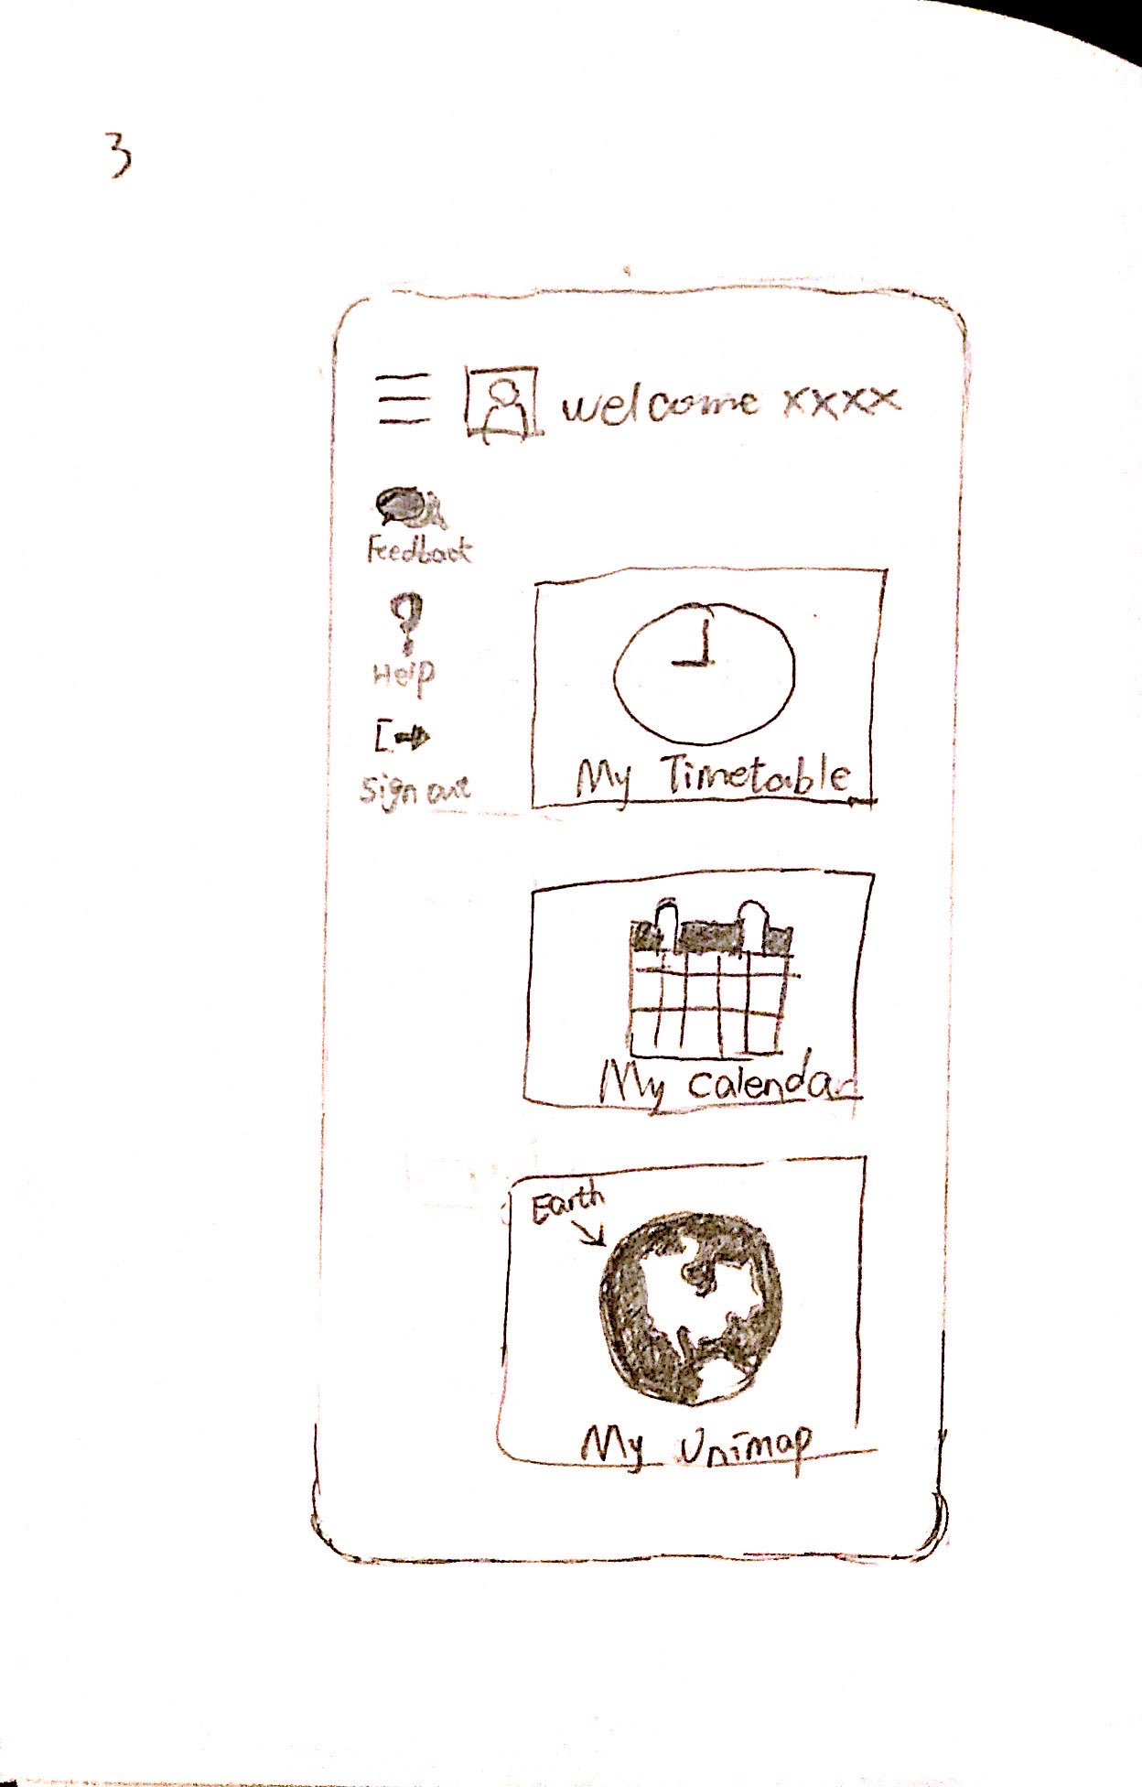
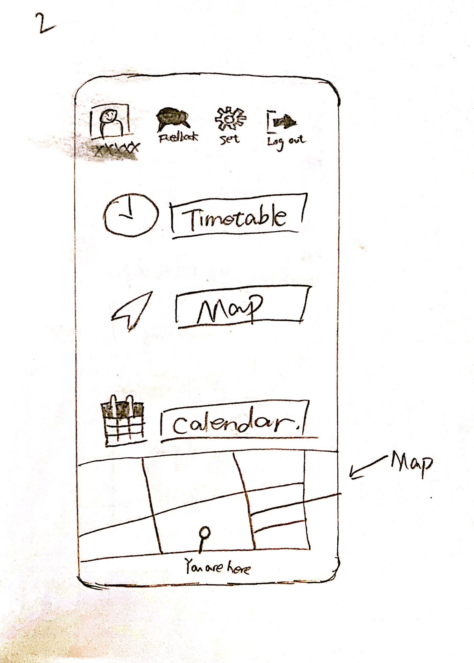
Two most promising prototypes

Slide 7
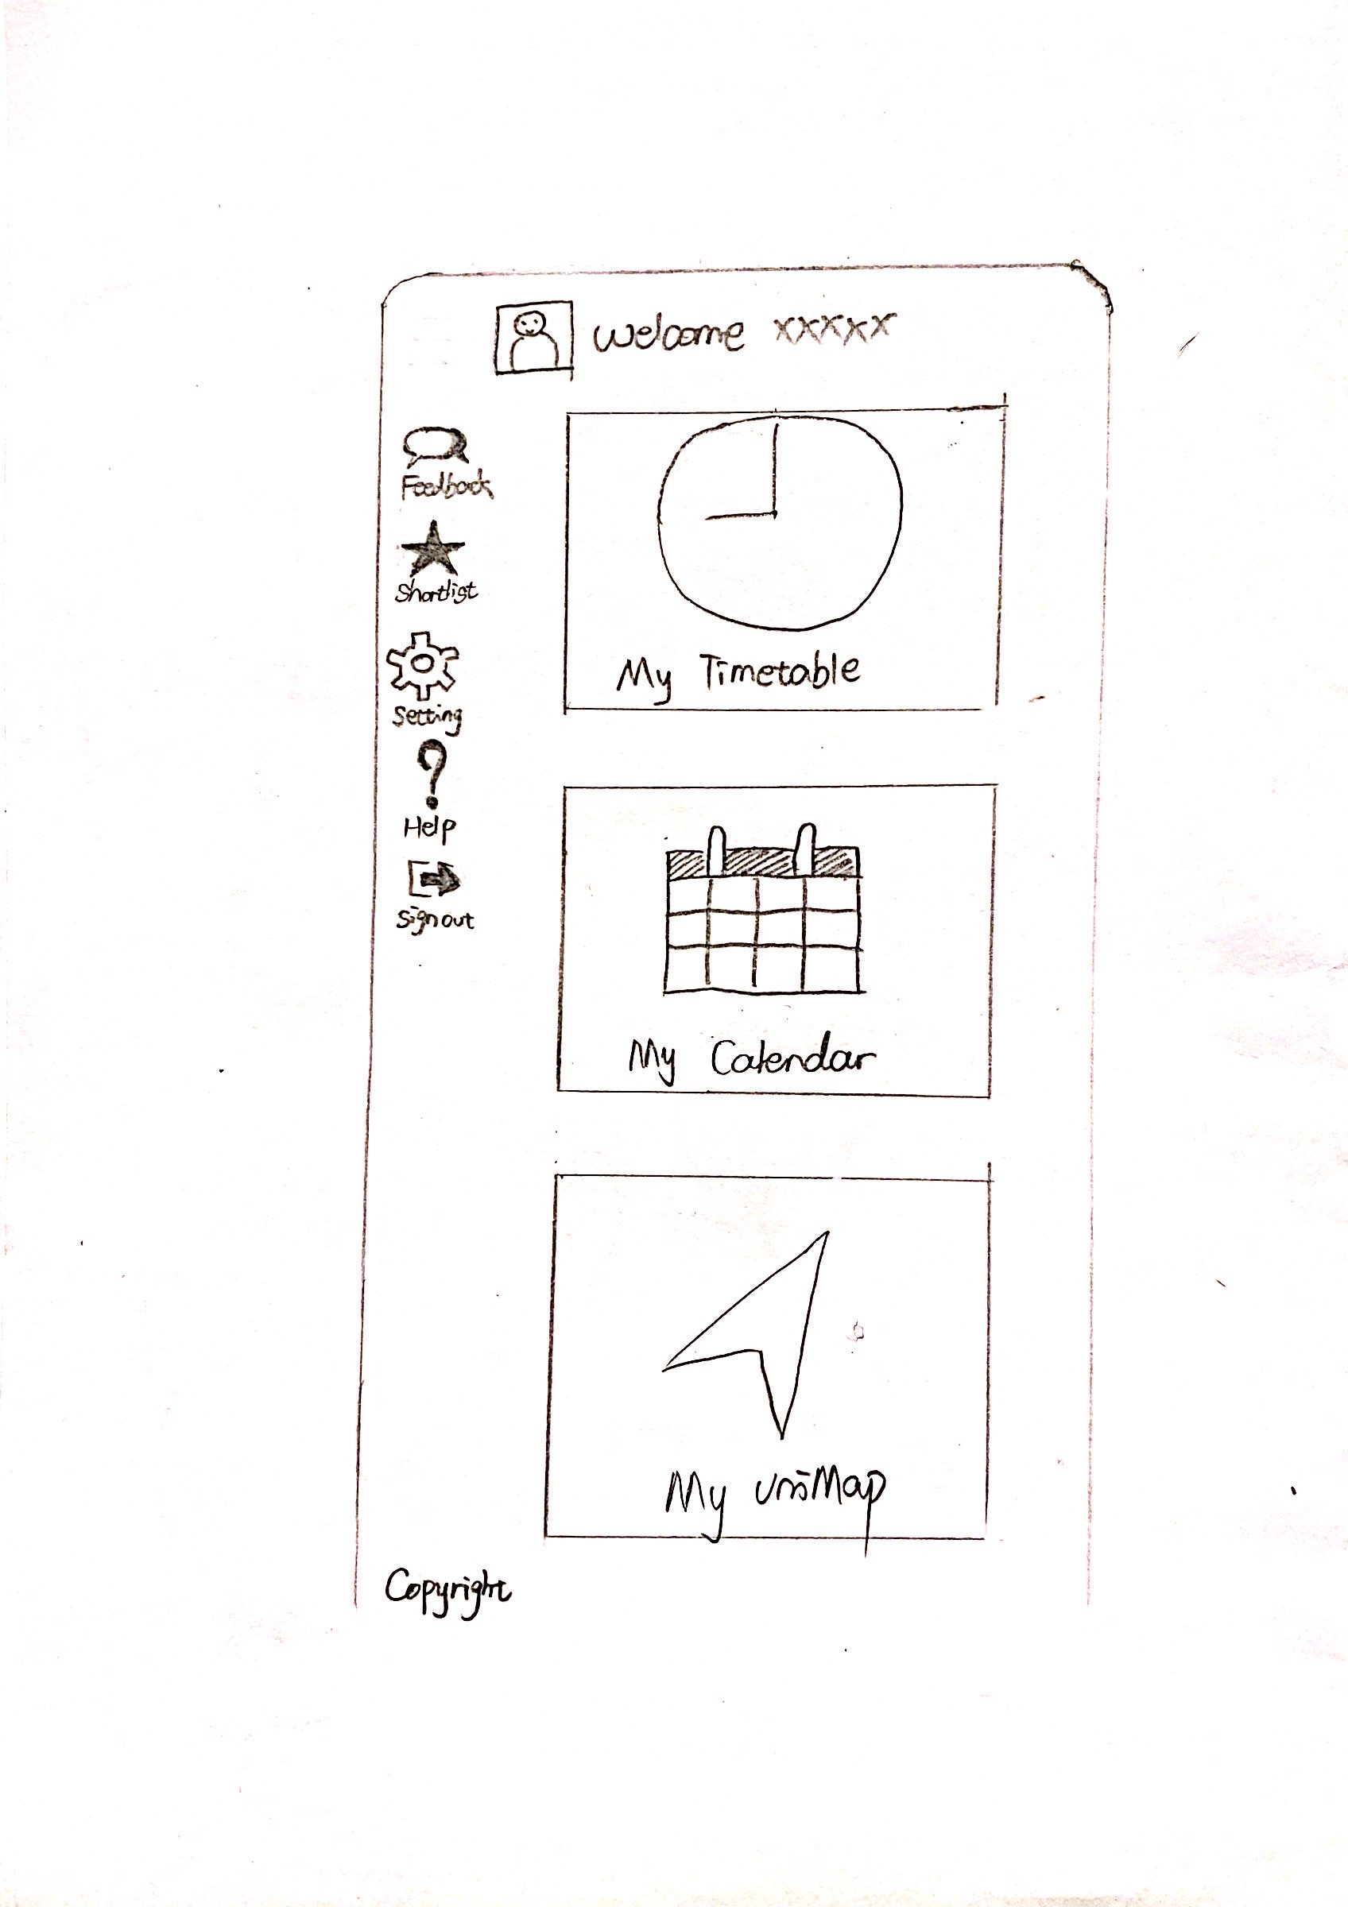
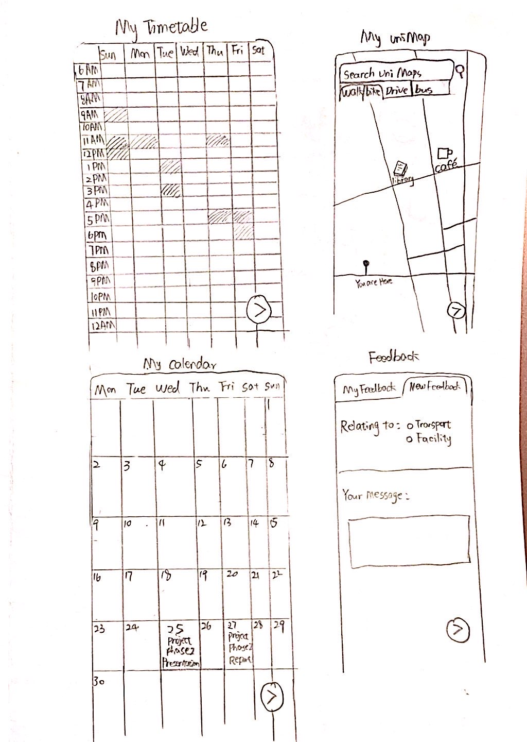
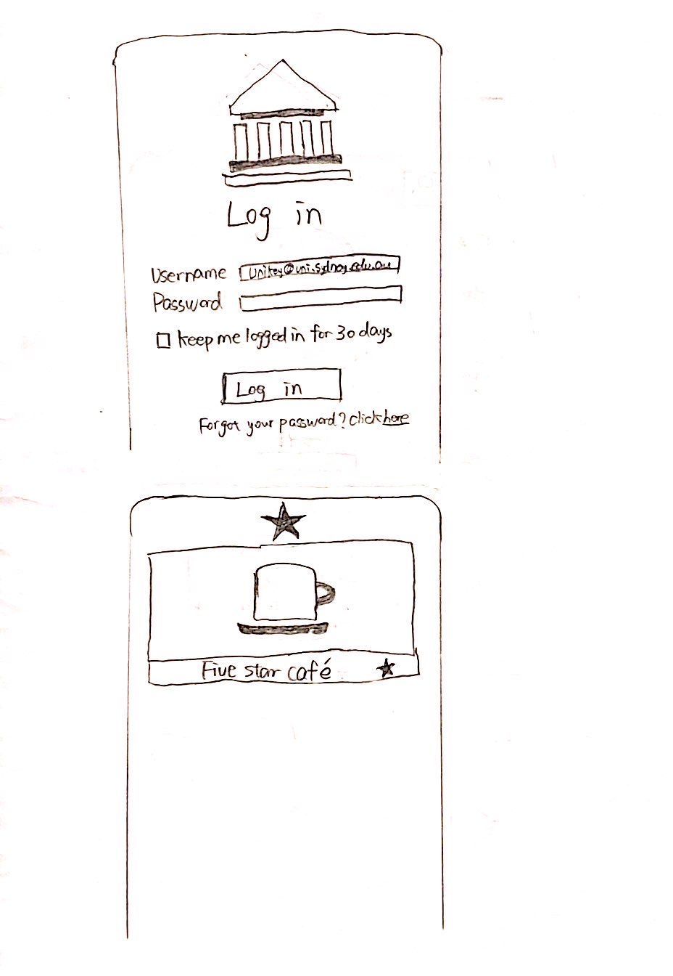

Prototype set 1/2
Concise but mediocre

Slide 8
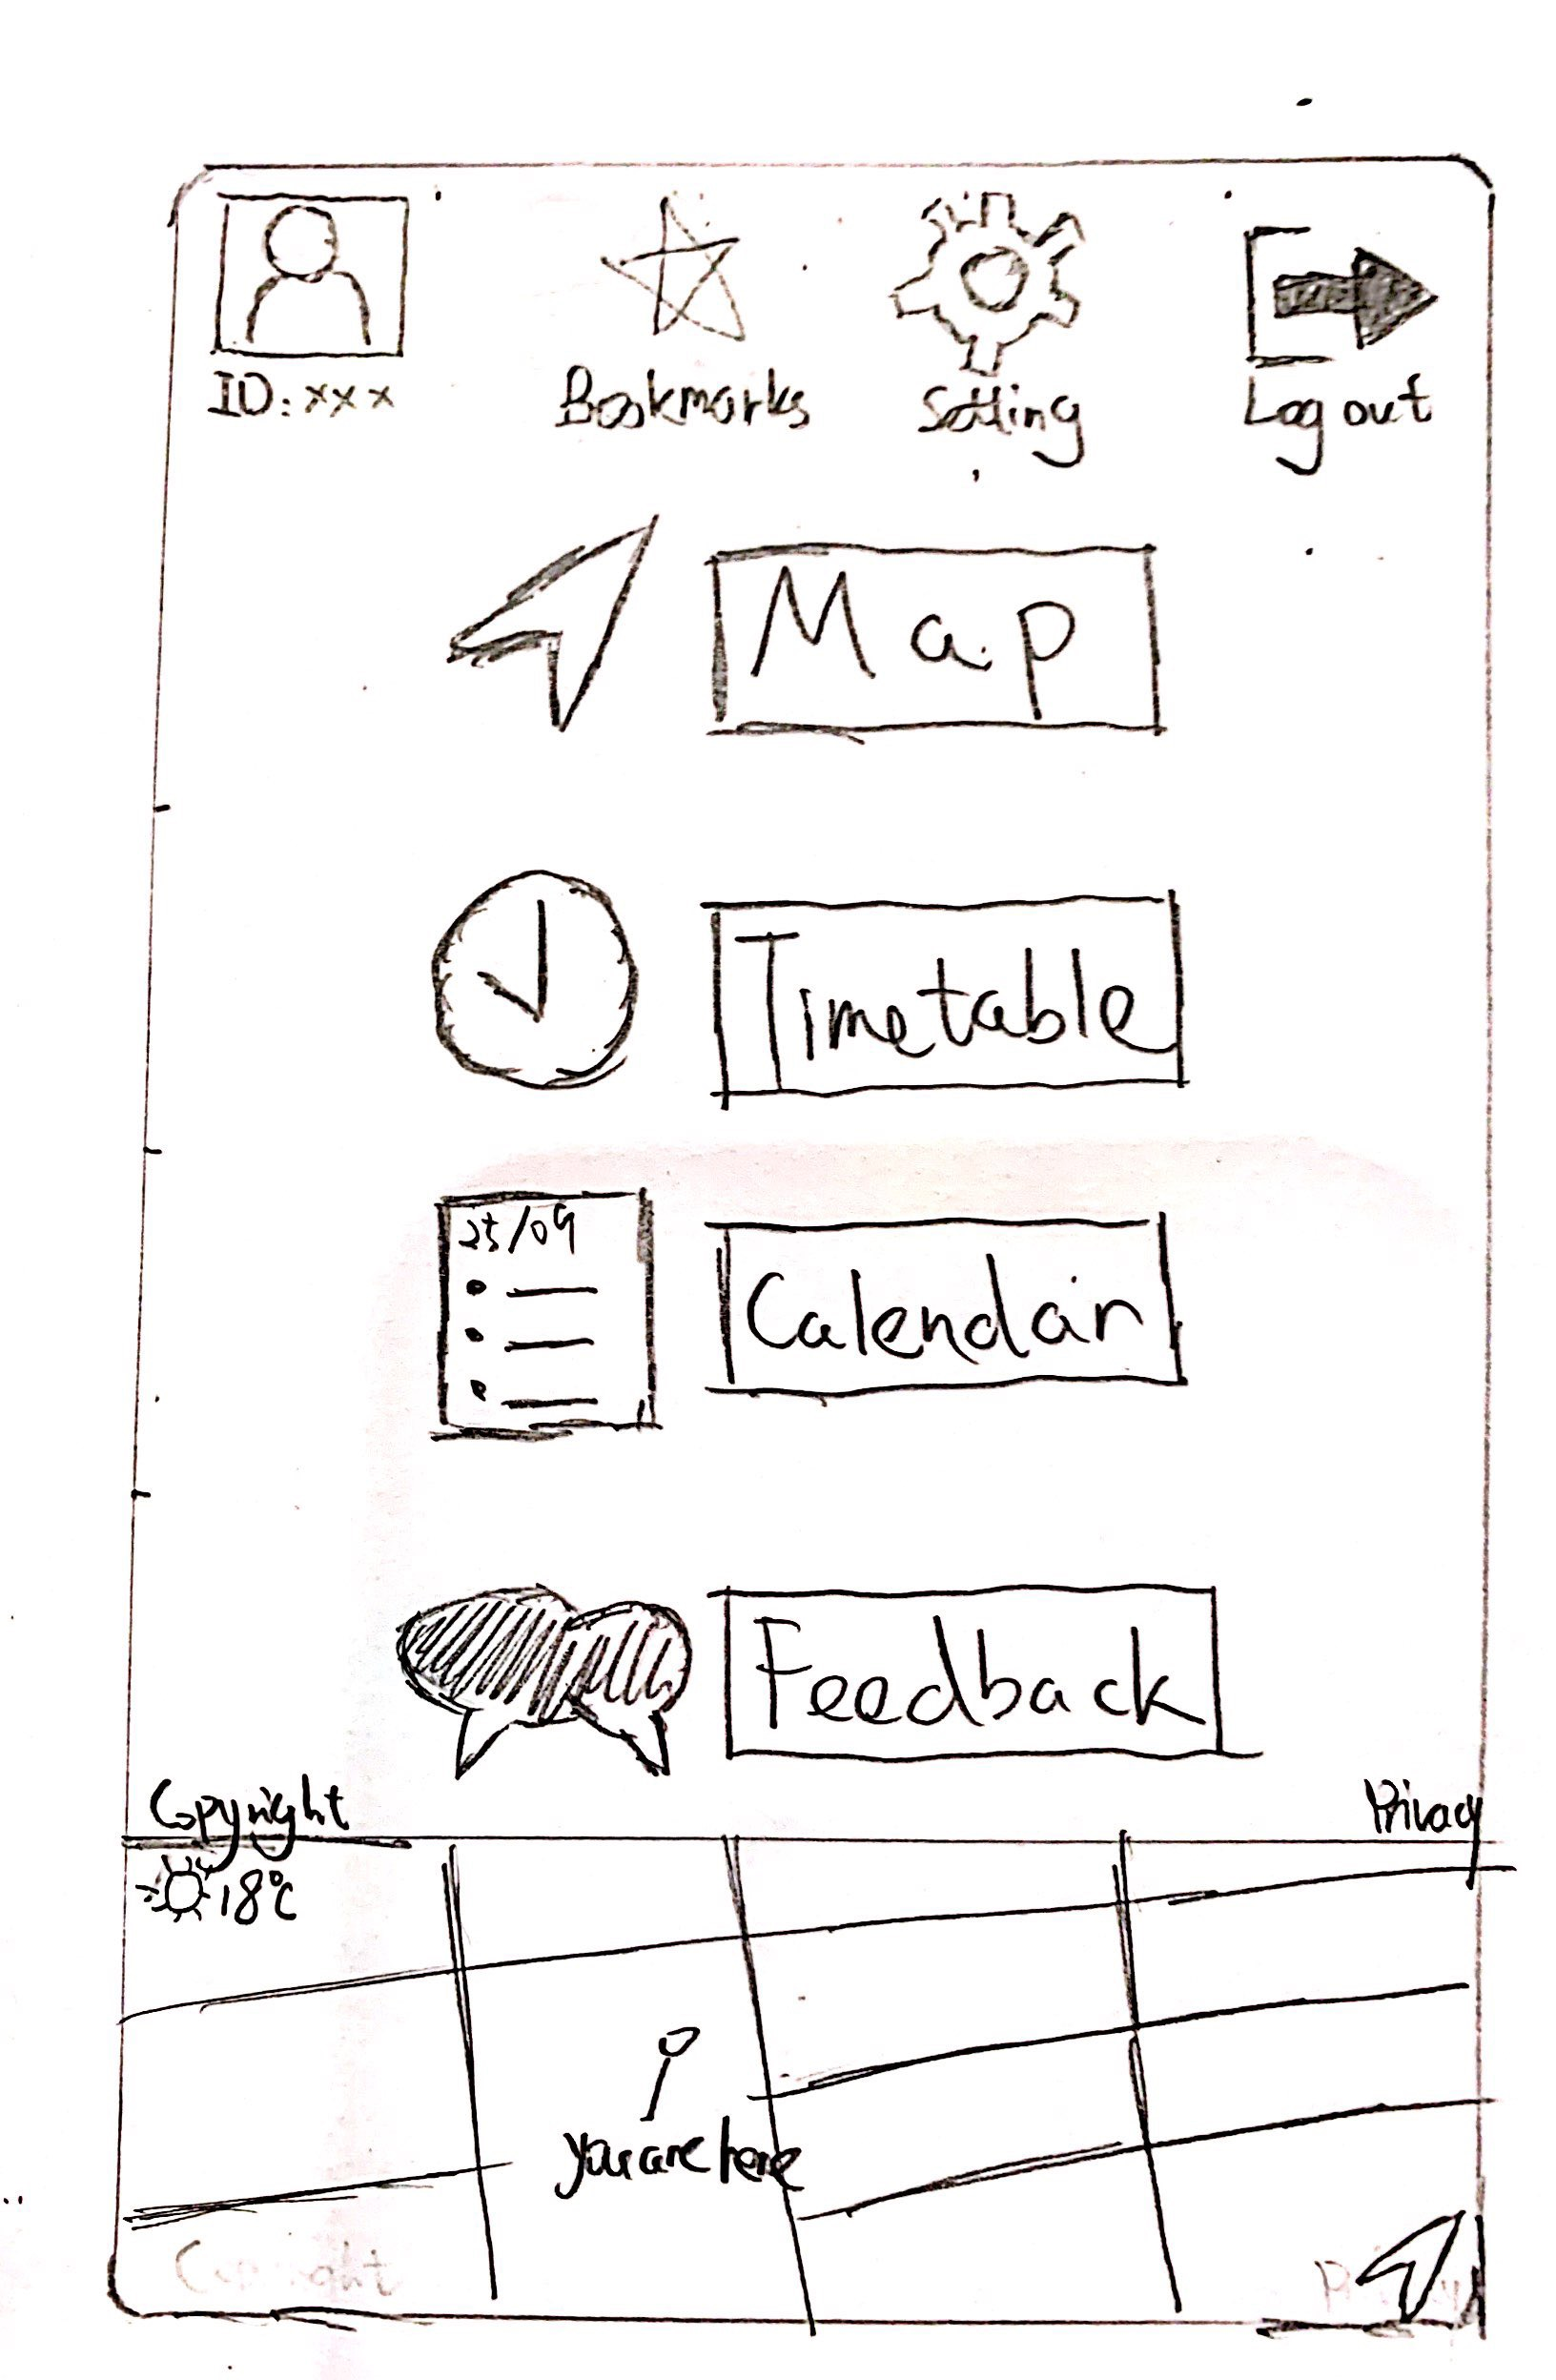
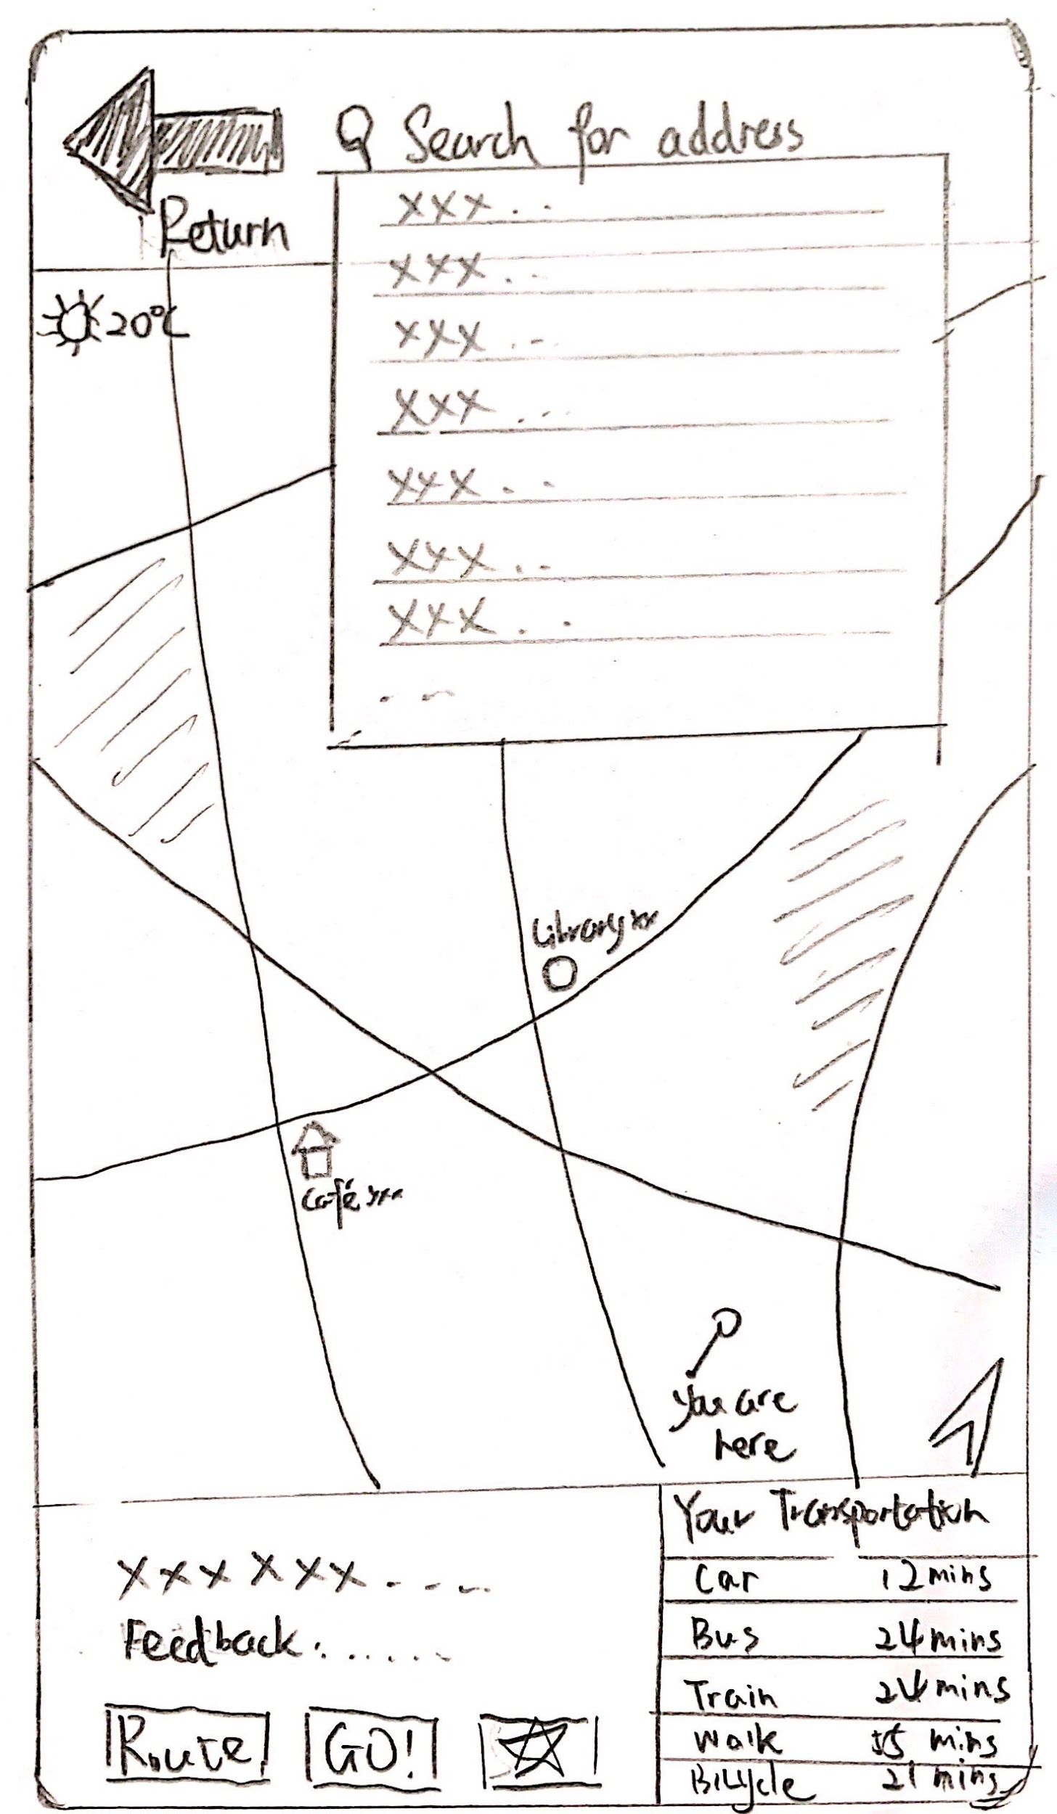
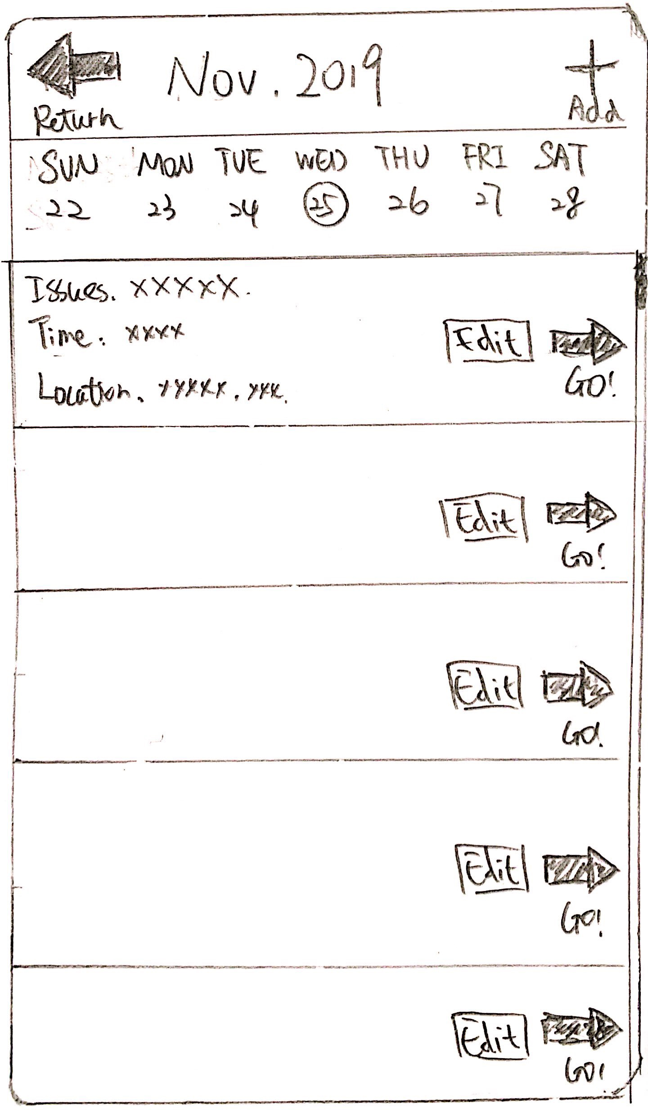
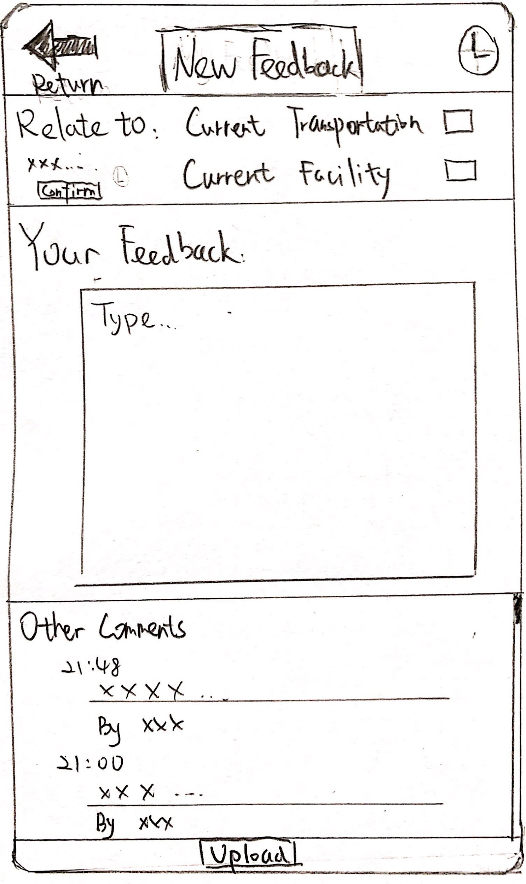
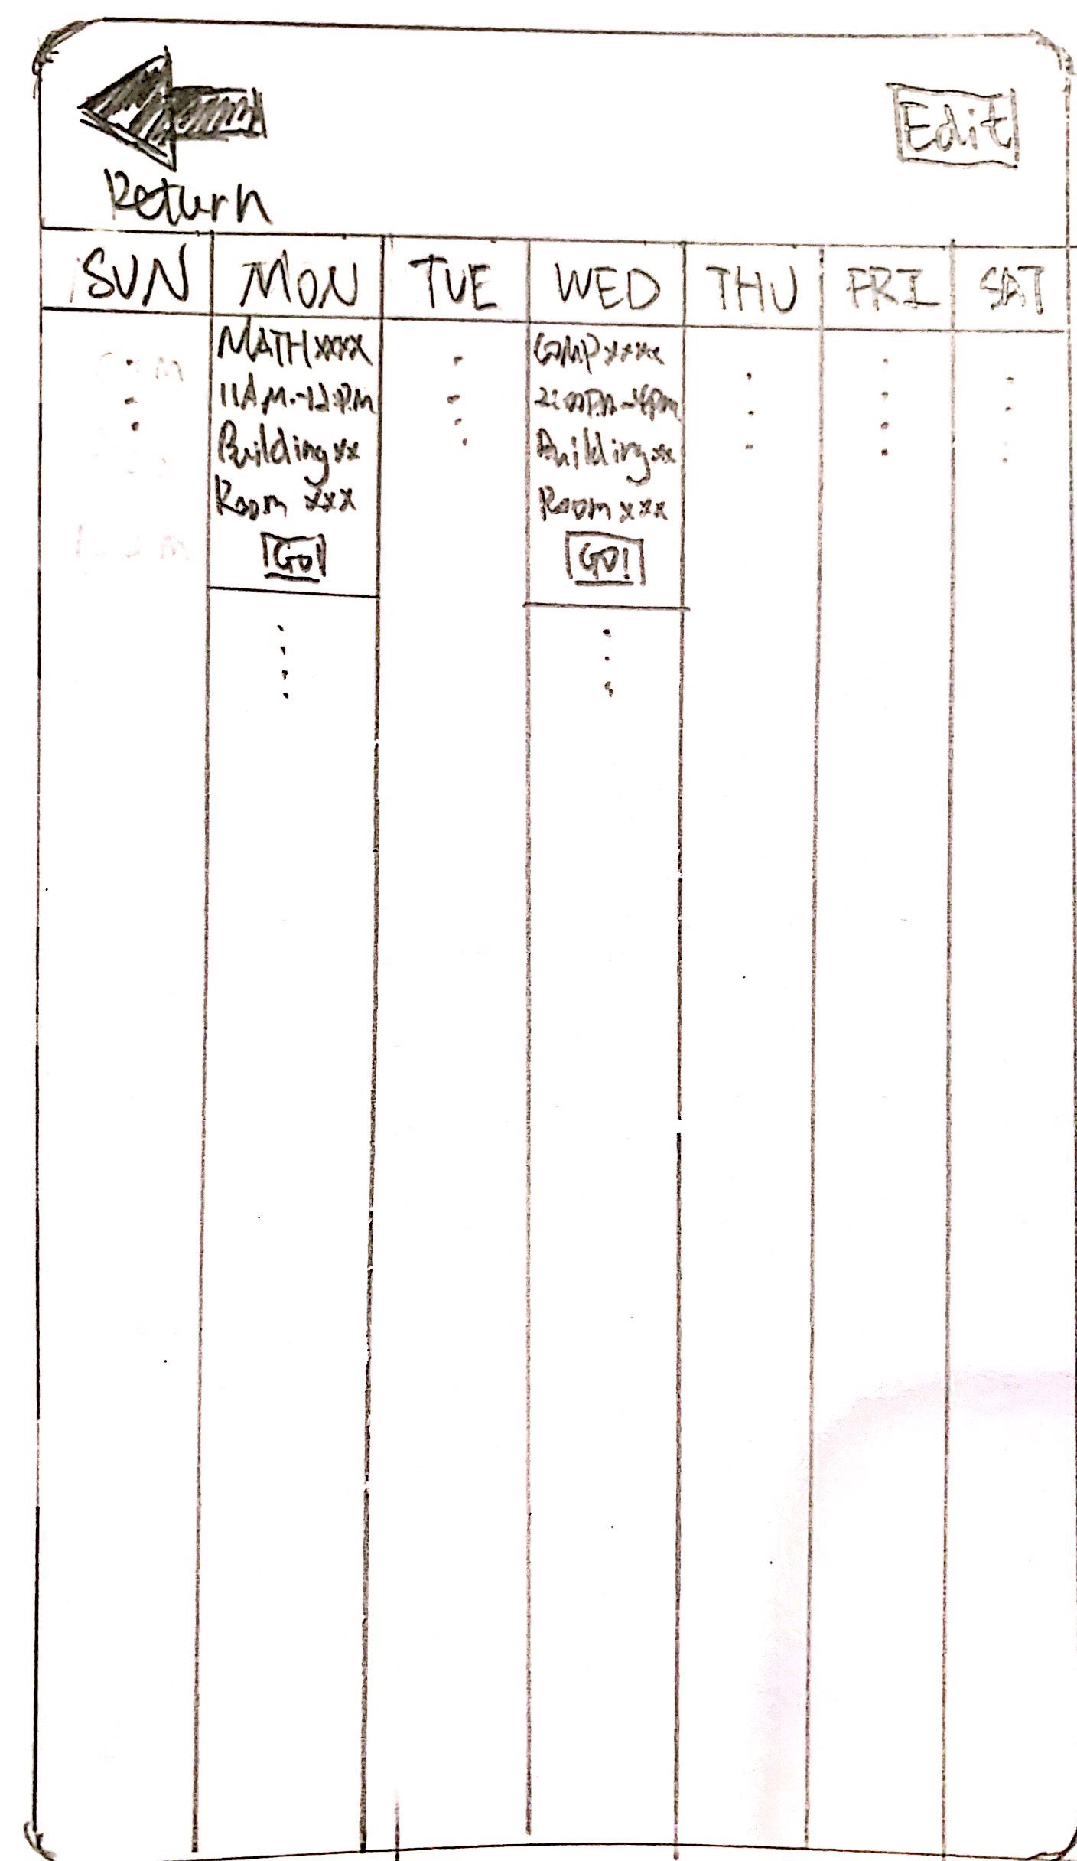
Prototype set 2/2
Rich but complicated

Slide 9
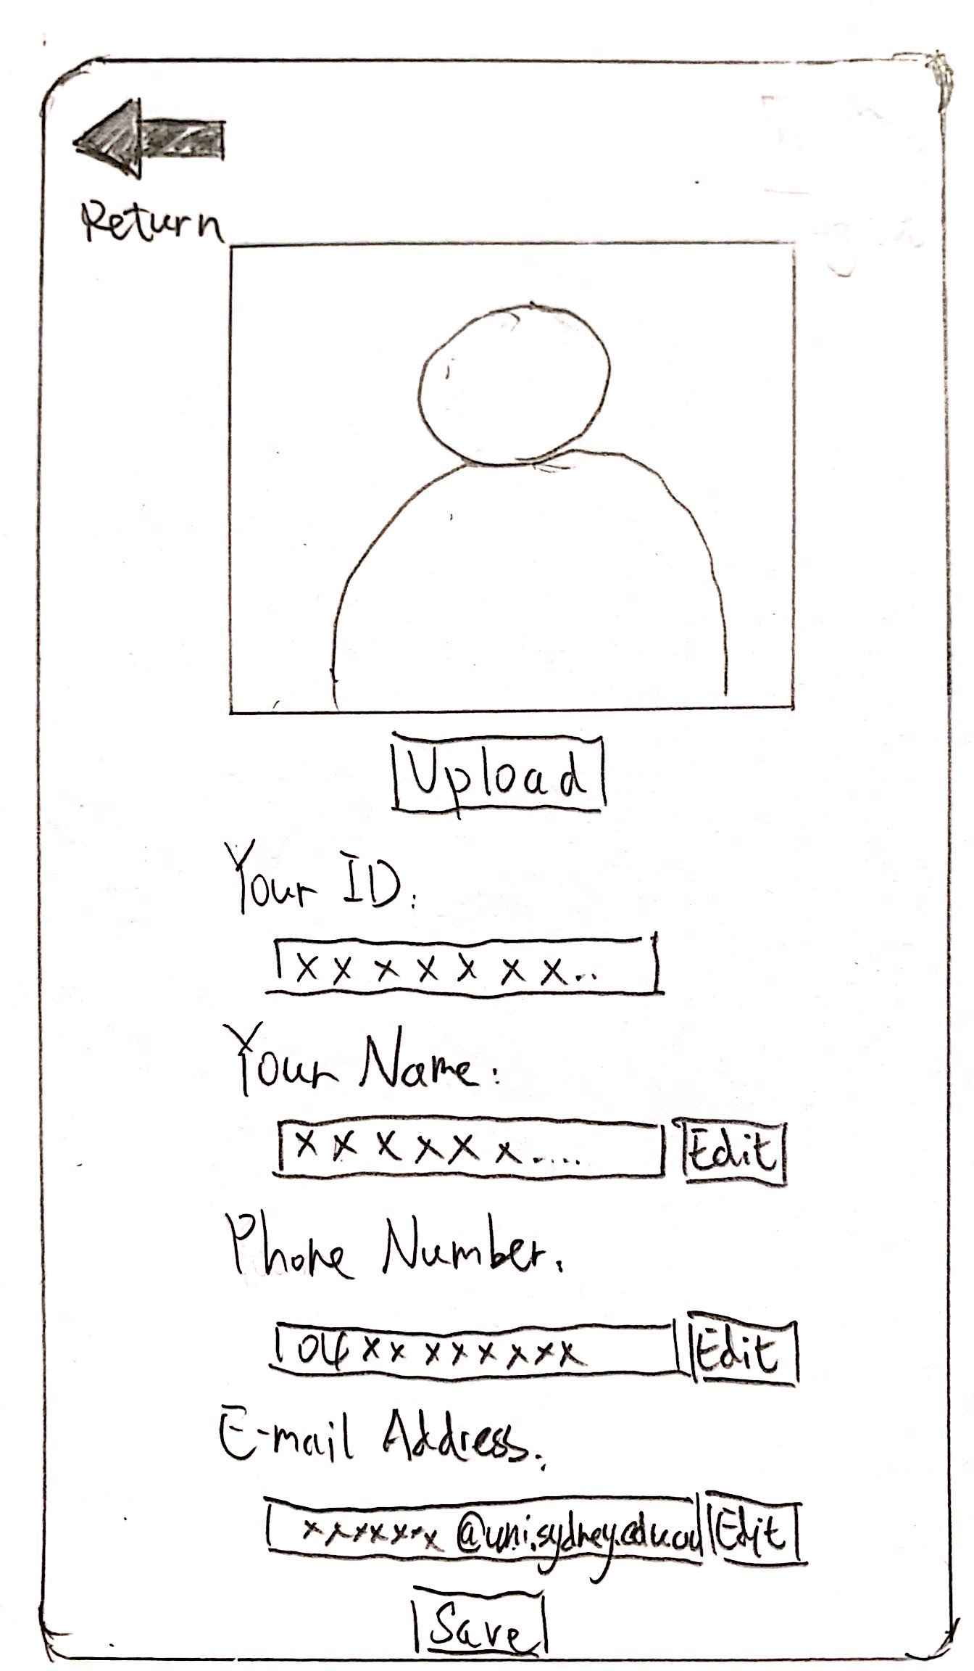
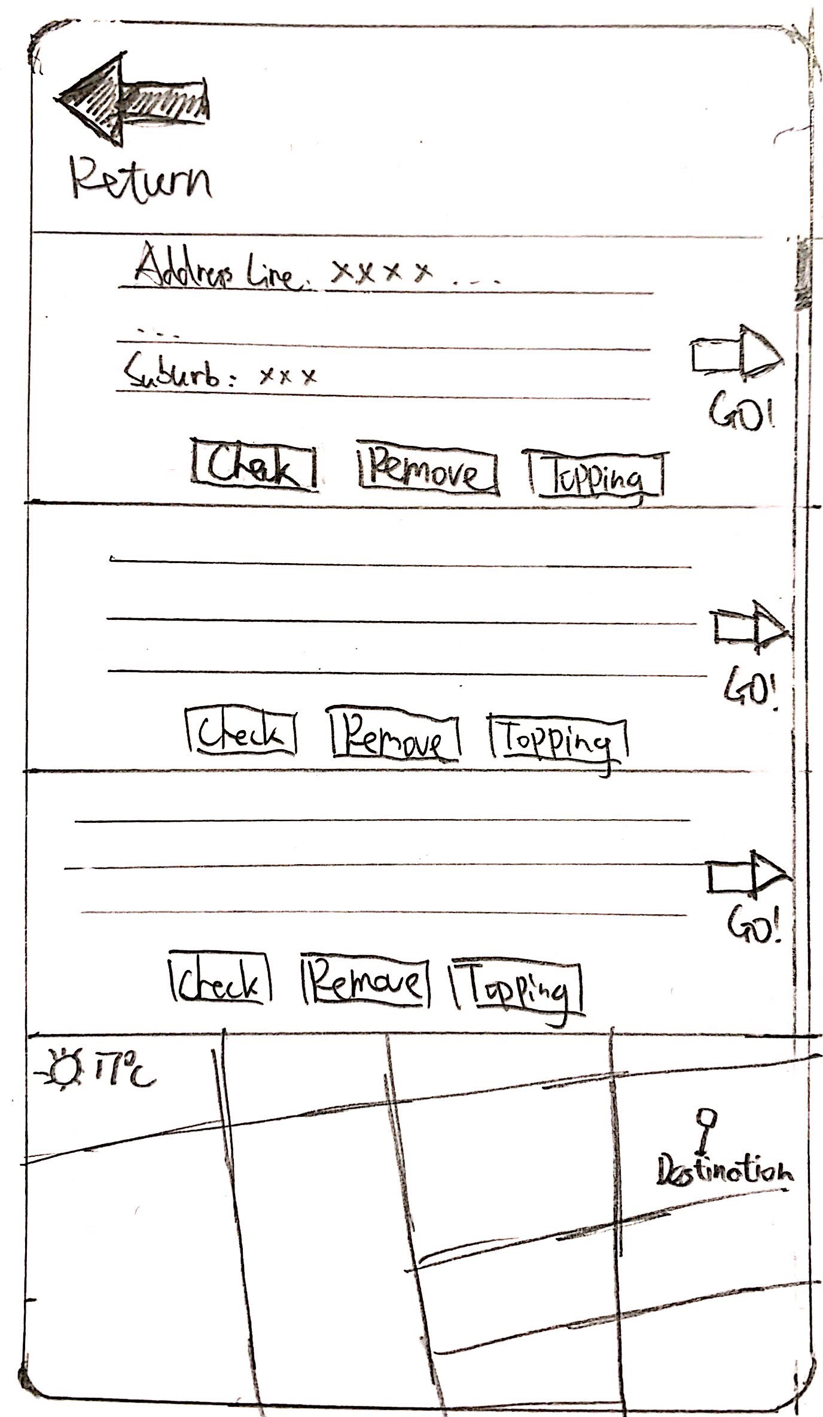
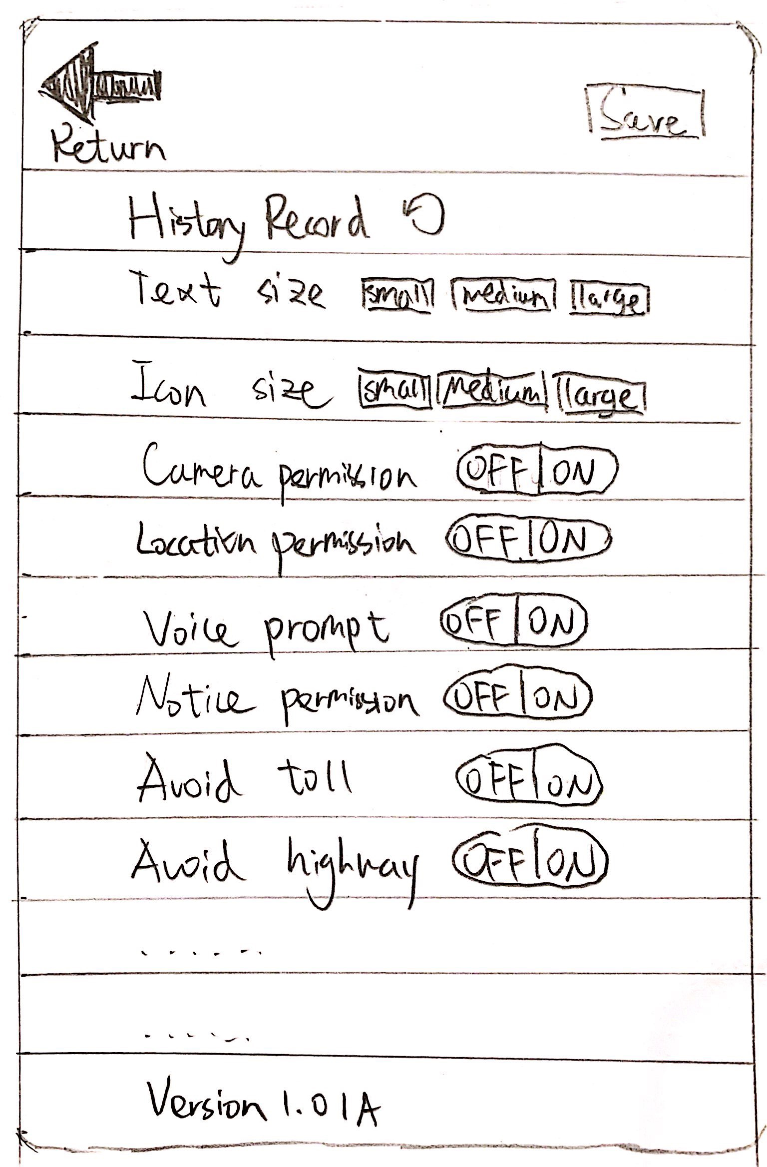
Prototype set 2/2 - The strongest design

Slide 10
Thank you !
Any question?

